Slide 1


SAP UI5 & FIORI with OData TRAINING
Anubhav Oberoy & Shekhar Vedi
Day – 2

Slide 2

Agenda – Day 2
Understanding the Client Server Architecture
Introduction to the Multimedia Tags
Understanding how to create Table using HTML
Introduction to the CSS
Why we use CSS
Introduction to Inline CSS
Introduction the Internal CSS
Introduction the External CSS
Understanding the Box Model in CSS
Introduction to JavaScript
Why we use JavaScript

Slide 3
Client Server Architecture
The task of the client/server technology components is to provide a reusable runtime environment for other components that use the client server technology as the basis on which to process requests. The focus is on optimizing operating system resources (CPU, memory, etc.), in terms of performance, scalability, and robustness.
In addition to the components in the SAP kernel there are programs that regulate data traffic in the network, such as the SAP router and the SAP Web Dispatcher, as well as smaller monitoring and test programs.
SAP Server Computer on cloud IP Address
Server
149.175.58.1
Request – header + body(optional)
Browser
JS Code
Fiori App
Response – header + body(html, xml, json, excel, pdf, word,….)
Node JS
Request Types
GET – Read Data
POST – Create new Data
PUT – Update
DELETE – Remove Data
ABAP
Java
,NET
Java Script
Form Submit
HTTP Request
Ajax Call

Slide 4

Introduction to Multimedia Tags in HTML
Multimedia on the web is sound, music, videos, movies, and animations.
Multimedia comes in many different formats. It can be almost anything you can hear or see, like images, music, sound, videos, records, films, animations, and more.
HTML helps you to add multimedia files on your website by providing various multimedia tags. ... These tags include AUDIO, VIDEO, EMBED, and OBJECT. The AUDIO tag is used to display the audio file on the Web page, whereas the VIDEO tag is used to display the video files on the Web page. To access the methods and properties of a UI Control, We cannot use the document object which is a plain HTML element object.
HTML Attributes Documentation at https://www.w3schools.com/html/html_media.asp
Video
The HTML <video> element is used to show a video on a web page.
The controls attribute adds video controls, like play, pause, and volume.
Audio
The HTML <audio> element is used to play a audio file on a web page.
The controls attribute adds video controls, like play, pause, and volume.
You Tube
This is the easiest way to embed videos in HTML.
The HTML <iframe> element is used to add YouTube videos in the web page.
We can also add complete websites to our web page using this tag.

Slide 5

Exercise
Now we will add some media elements like audio and video in our web page using the multimedia tags like <video>, <audio>
Exercise Code:
index.html

Slide 6
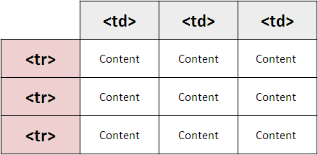
Introduction to Table element in HTML
HTML tables allow web developers to arrange data into rows and columns.
A table in HTML consists of table cells inside rows and columns A simple HTML table, containing two columns and two rows
The <table> tag defines an HTML table.
An HTML table consists of one <table> element and one or more <tr>, <th>, and <td> elements.
The <tr> element defines a table row, the <th> element defines a table header, and the <td> element defines a table cell.
An HTML table may also include <caption> <colgroup>, <thead>, <tfoot>, and <tbody> elements.
By default, the text in <th> elements are bold and centered, but you can change that with CSS.

Slide 7

Exercise
Now we will create a Simple table using the html <table> tag and will also add some demo data to the table using the <tr> and <td> tags.
Exercise Code:
index.html

Slide 8

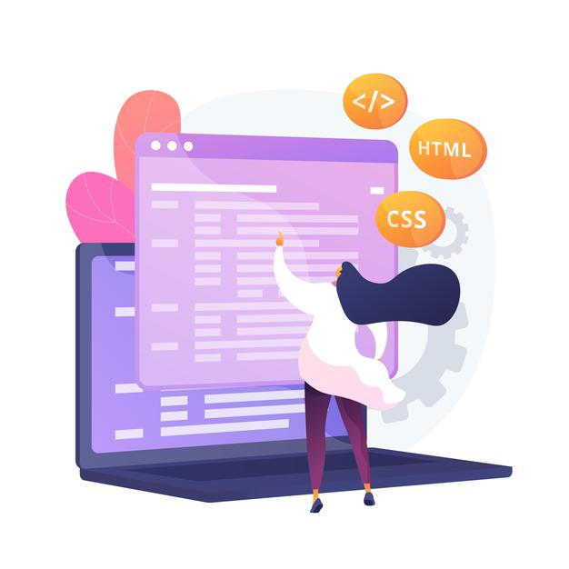
Introduction to CSS
CSS Stands for Cascading Style Sheets
CSS describes how HTML elements are to be displayed on screen, paper, or in other media.
CSS saves a lot of work. It can control the layout of multiple web pages all at once.
External stylesheet are stored in CSS file.
We need CSS because HTML can only generate static content w/o coloring, formatting, borders, beautification.
Ways of applying CSS in an HTML :-
01 Inline CSS
02 Internal CSS
03 External CSS
In Inline Style CSS is applied along with HTML Element
In Internal type the CSS is applied at the Page level
In External type the a separate CSS file is created and linked to the Page

Slide 9
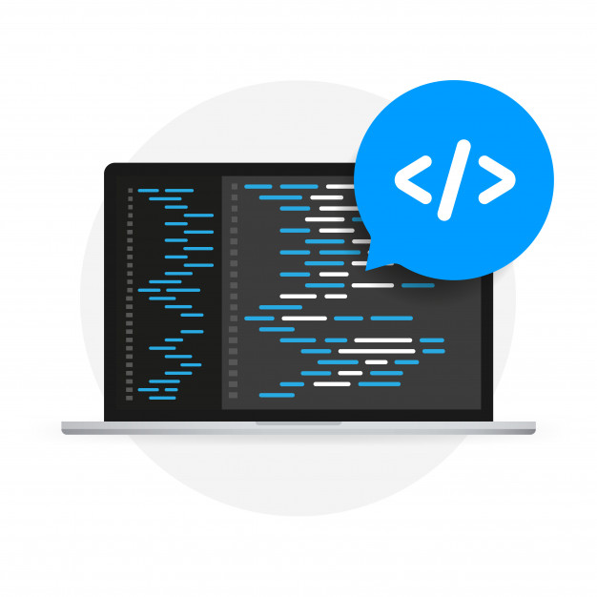
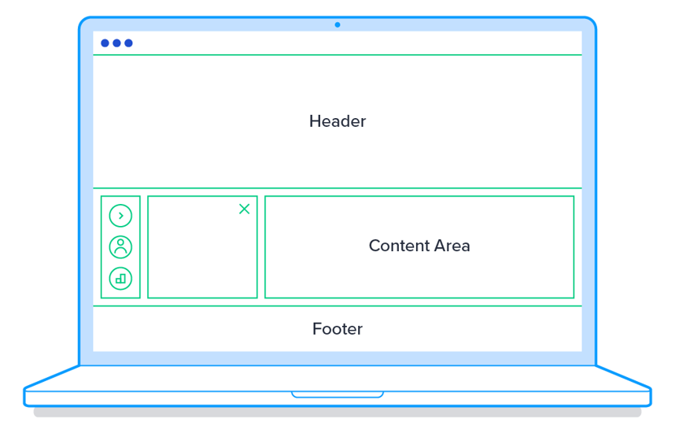
Why Use CSS
CSS helps we to keep the informational content of a document separate from the details of how to display it
The details of how to display the document are known as its style.
We keep the style separate from the content so that you can:
Avoid duplication
Make maintenance easier
Use the same content with different styles for different purposes
In general, you use HTML to describe the content of the document, not its style; you use CSS to specify its style, not its content.

Slide 10
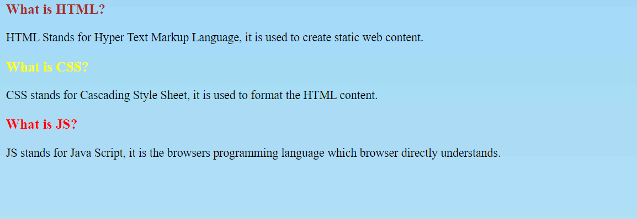
Inline CSS
Inline CSS: Inline CSS contains the CSS property in the body section attached with element is known as inline CSS. This kind of style is specified within an HTML tag using the style attribute.
We use a style attribute to assign CSS styling properties.
Inline styles in CSS could be useful for previewing changes instantly or adding CSS rules to only one or two elements. When you don't have access to your .css file, knowing how inline style CSS works can be convenient.
The following example sets the text color of the <h3> element to brown:
<div class="box-title">
<h3 style="color: brown;">What is HTML?</h3>
</div>
CSS Colors, Fonts and Sizes
The CSS color property defines the text color to be used
The CSS font-family property defines the font to be used.
The CSS font-size property defines the text size to be used.

Slide 11

Exercise
Now we will understand how to apply CSS to html elements using the Inline method.
Exercise Code:
index.html
Bgimage.jpeg

Slide 12
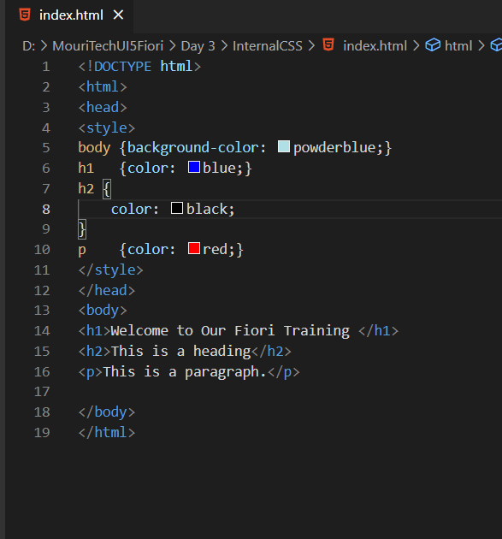
Internal CSS
Internal or Embedded CSS: This can be used when a single HTML document must be styled uniquely. The CSS rule set should be within the HTML file in the head section i.e. the CSS is embedded within the HTML file.
A Internal style sheet may be used if one single page has a unique style
Internal Style sheet are created using <style> element, which is added inside the <head> element of the HTML document.
You can define any number of <style> elements in an HTML document but they must appear between the <head> and </head> tags.
Syntax to Apply CSS in Internal mode
<style>
selector {
propertyname: value;
propname: value;
}
</style>

Slide 13

Exercise
Now we will understand how to apply the CSS internally in the HTML file.
For that we will use the <style> tag in the <head> tag in the HTML.
Exercise Code/Resource:
index.html

Slide 14
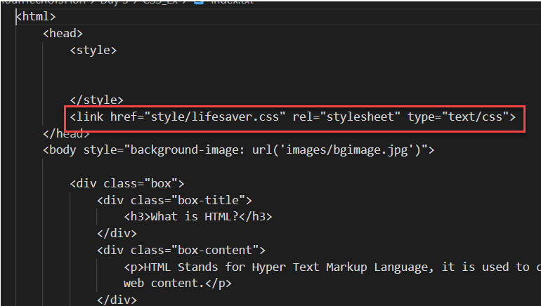
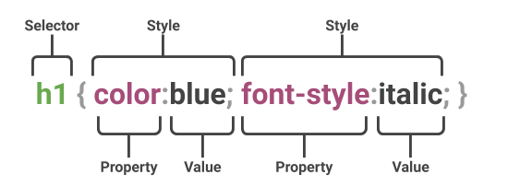
External CSS
External CSS: External CSS contains separate CSS file which contains only style property with the help of tag attributes (For example class, id, heading, … etc). CSS property written in a separate file with .css extension and should be linked to the HTML document using link tag. This means that for each element, style can be set only once and that will be applied across web pages.
You can attach external style sheets in two ways — linking and importing.
Define style sheet rules in a separate .css file and then include that file in your HTML document using HTML <link> tag.
Before linking, we need to create a style sheet first. Let's open your favorite code editor and create a new file. Now type the following CSS code inside this file and save it as "style.css".
An external style sheet can be linked to an HTML document using the <link> tag. The <link> tag goes inside the <head> section.

Slide 15

Box Model in CSS
In CSS, the term "box model" is used when talking about design and layout.
All HTML elements can be considered as boxes.
The CSS box model is essentially a box that wraps around every HTML element. It consists of: margins, borders, padding, and the actual content. The image below illustrates the box model:
1
Content: The Content of the box, where text and images appear
Explanation of the different parts
2
Padding: Clears an area around the content. Padding is transparent.
3
Border: A border that goes around the padding and content.
4
Margin: Clears an area outside the border. The margin is transparent.

Slide 16

Exercise
Now we will understand how to apply the CSS to the HTML file form an external file.
For this we will create a new folder named style in the working directory and in that folder, we will create a file named lifesaver.css
Exercise Code/Resource:
index.html
lifesaver.css

Slide 17


Introduction to JavaScript
JavaScript is the programming language of the Web.
JavaScript is the world's most popular programming language.
It is an asynchronous non-blocking IO language.
JavaScript is a text-based programming language used both on the client-side and server-side that allows you to make web pages interactive.
Client-side JS – When code runs on Browser.
Server-side JS – When the code runs on webserver, e.g. NodeJS
Where HTML and CSS are languages that give structure and style to web pages, JavaScript gives web pages interactive elements that engage a user.
???
What we can do with JS?
Why Study JavaScript?
JavaScript is one of the 3 languages all web developers must learn:
1. HTML to define the content of web pages
2. CSS to specify the layout of web pages
3. JavaScript to program the behavior of web pages
We can show output to the user
Change the CSS at runtime
Validate the data
Manipulate the DOM
Send server requests
Dynamically change and add Element on the screen

Slide 18

End of Day 2

Slide 19

Questions

Slide 20

Anubhav Oberoy

Slide 21


We’re committed to empower you to be
Most Desirable Resource
through powerful training solutions.
We build the workforce of the future.
250+
Corporate Clients
30,000+
Learners Trained
25000+
Learners Placed
FREE WEBINARS
Sign up for free webinars with industry experts every fortnight!
Enroll Now!
Contact us today!
https://anubhavtrainings.com/

Slide 22




More from AnubhavTrainings.com

Slide 23
Title
Content

